Slide 1
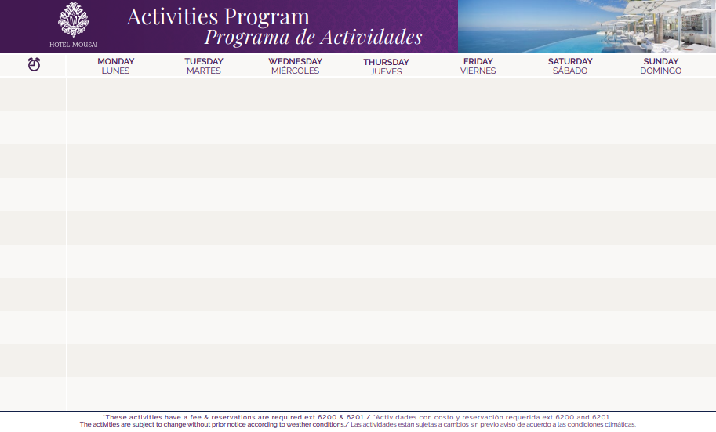
04
05
06
07
08
09
10
Kayak & Snorkeling Los Arcos
Meeting Point - at the beach
Experience Required 2.5 Hrs. Age / Edad 12+
Reservation Required
Kayak & Snorkeling Los Arcos
Meeting Point - at the beach
Experience Required 2.5 Hrs. Age / Edad 12+
Reservation Required
Kayak & Snorkeling Los Arcos
Meeting Point - at the beach
Experience Required 2.5 Hrs. Age / Edad 12+
Reservation Required
Kayak & Snorkeling Los Arcos
Meeting Point - at the beach
Experience Required 2.5 Hrs. Age / Edad 12+
Reservation Required
Kayak & Snorkeling Los Arcos
Meeting Point - at the beach
Experience Required 2.5 Hrs. Age / Edad 12+
Reservation Required
Kayak & Snorkeling Los Arcos
Meeting Point - at the beach
Experience Required 2.5 Hrs. Age / Edad 12+
Reservation Required
Kayak & Snorkeling Los Arcos
Meeting Point - at the beach
Experience Required 2.5 Hrs. Age / Edad 12+
Reservation Required
08:00
08:45
Vinyāsa Yoga Class
At TierraLuna Village
Meeting Point - Lobby GB
Stretching Class At TierraLuna Village
Meeting Point - Lobby GB
Yin Yoga Class At TierraLuna Village
Meeting Point - Lobby GB
Restorative Yoga
At TierraLuna Village
Meeting Point - Lobby GB
Stretching Class At TierraLuna Village
Meeting Point - Lobby GB
Senderismo INTERMEDIO
INTERMEDIATE Hike Mountain 2 Hrs. Meeting Point - Lobby Mousai
Excursion a LA CASCADA
Hike to the WATERFALL River & Waterfall 2 Hrs. Meeting Point - Lobby Mousai
Senderismo ARCOS
ARCOS Hike 2.5 Hrs. Mountain & TierraLuna Meeting Point - Lobby Mousai
Senderismo AVANZADO
Hiking ADVANCED 2.5 Hrs.
Mountain, Waterfall & River
Meeting Point - Lobby Mousai
Senderismo ARROYOS
TREKKING Hike
Mountain 2.0 Hrs. Meeting Point - Lobby Mousai
Excursion a LA CASCADA
Hike to the WATERFALL River & Waterfall 2 Hrs. Meeting Point - Lobby Mousai
Senderismo AVANZADO
Hiking ADVANCED 2.5 Hrs.
Mountain, Waterfall & River
Meeting Point - Lobby Mousai
10:10
Kayaking Ocean Tour Experience Required 2 Hrs. Age / Edad 12+
Reservation Required
Paddle Board Clinics Clínicas De Paddle Board
Know Swim is required
Age / Edad 12+
Kayaking Ocean Tour Experience Required 2 Hrs. Age / Edad 12+
Reservation Required
Paddle Board Clinics Clínicas De Paddle Board
Know Swim is required
Age / Edad 12+
Kayaking Ocean Tour Experience Required 2 Hrs. Age / Edad 12+
Reservation Required
Paddle Board Clinics Clínicas De Paddle Board
Know Swim is required
Age / Edad 12+
Kayaking Ocean Tour Experience Required 2 Hrs. Age / Edad 12+
Reservation Required
11:30
12:00
Anyone can cook Ceviche
By the beach pool
* Catch of the day Pesca del día By the beach pool 12:30 Hrs.
13:00
Bocce Ball
Meeting Point - Lobby GB
Horseshoes Game
Juego de Herraduras Meeting Point - Lobby GB
Bocce Ball
Meeting Point - Lobby GB
Horseshoes Game
Juego de Herraduras Meeting Point - Lobby GB
Bocce Ball
Meeting Point - Lobby GB
Horseshoes Game
Juego de Herraduras Meeting Point - Lobby GB
Bocce Ball
Meeting Point - Lobby GB
* Wine Tasting
Reservation Required
Meeting Point - BocaDos STK Reservation Required
* WineTasting
Reservation Required
Meeting Point - BocaDos STK Reservation Required
16:00
16:30
* Tequila Tasting Reservation Required At Blanca Blue Restaurant
17:00
Members Cocktail Coctel para Socios Bar Noi 360°
Elite Members Cooking Class
Clase de Cocina para Elite Members Orange Deck
19:00
* BOHEMIAN NIGHT Noche Bohemia Live Guitar Music At TierraLuna Village
* FIESTA MEXICANA Mariachi & Folkloric Show At TierraLuna Village
* BOHEMIAN NIGHT Noche Bohemia Live Guitar Music At TierraLuna Village
* BOHEMIAN NIGHT Noche Bohemia Live Guitar Music At TierraLuna Village
* BBQ NIGHT At TierraLuna Village
* BOHEMIAN NIGHT Noche Bohemia Live Guitar Music At TierraLuna Village
* LATIN NIGHT Noche Latina & Art Walk Latin Live Music At TierraLuna Village

