Slide 1
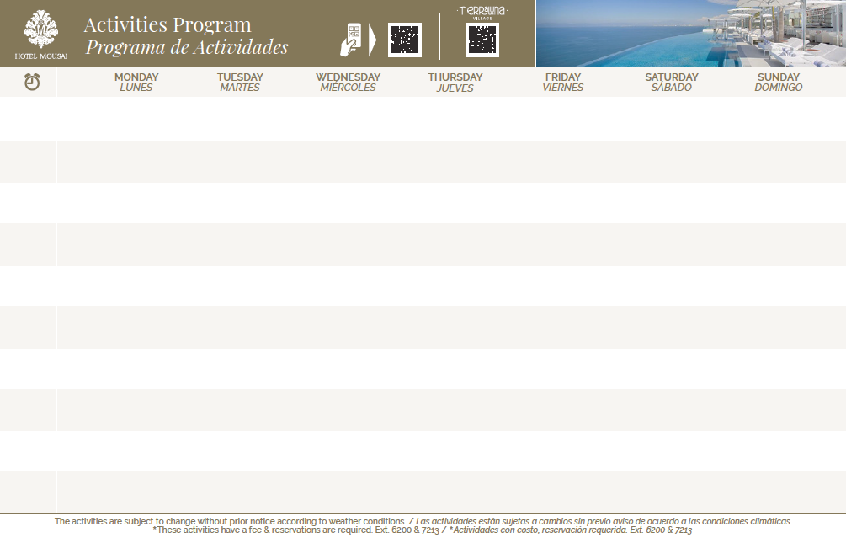
03
04
05
06
07
08
09
Kayak & Snorkeling Los Arcos
Meeting Point - at beach
Experience Required
2.5 Hrs. Age / Edad 12+
Reservation Required
Kayak & Snorkeling Los Arcos
Meeting Point - at beach
Experience Required
2.5 Hrs. Age / Edad 12+
Reservation Required
Kayak & Snorkeling Los Arcos
Meeting Point - at beach
Experience Required
2.5 Hrs. Age / Edad 12+
Reservation Required
Kayak & Snorkeling Los Arcos
Meeting Point - at beach
Experience Required
2.5 Hrs. Age / Edad 12+
Reservation Required
Kayak & Snorkeling Los Arcos
Meeting Point - at beach
Experience Required
2.5 Hrs. Age / Edad 12+
Reservation Required
Kayak & Snorkeling Los Arcos
Meeting Point - at beach
Experience Required
2.5 Hrs. Age / Edad 12+
Reservation Required
Kayak & Snorkeling Los Arcos
Meeting Point - at beach
Experience Required
2.5 Hrs. Age / Edad 12+
Reservation Required
08:00
08:50
Kundalini Yoga Class
At TierraLuna Village
October Wellness 2022
Stretching Class
At TierraLuna Village
October Wellness 2022
Tai Chi Class
At TierraLuna Village
October Wellness 2022
Viyansa Yoga
At TierraLuna Village
October Wellness 2022
Hatha Yoga (Sivananda)
At TierraLuna Village
October Wellness 2022
Yin Yan Yoga
At TierraLuna Village
October Wellness 2022
10:10
Hike a la CASCADA
Hike to the WATERFALL
River & Waterfall 2.0 Hrs.
Meeting Point - Mousai North
Senderismo INTERMEDIO
INTERMEDIATE Hike
Mountain 2 Hrs.
Meeting Point - Mousai North
Senderismo ARCOS
ARCOS Hike 2.5 Hrs.
Mountain & TierraLuna
Meeting Point - Mousai North
Hiking AVANZADO
ADVANCED Hike / Mountain
River & Waterfall / 2.5 Hrs..
Meeting Point - Mousai North
Senderismo ARROYOS
ARROYOS Hike
Mountain 2.0 Hrs.
Meeting Point - Mousai North
Hike a la CASCADA
Hike to the WATERFALL
River & Waterfall 2.0 Hrs.
Meeting Point - Mousai North
Senderismo ARCOS
ARCOS Hike 2.5 Hrs.
Mountain & TierraLuna
Meeting Point - Mousai North
11:30
Kayaking Ocean Tour Experience Required
2 Hrs. Age / Edad 12+
Reservation Required
Kayaking Ocean Tour Experience Required
2 Hrs. Age / Edad 12+
Reservation Required
Sup Yoga Bliss
At the beach pool
October Wellness 2022
Kayaking Ocean Tour Experience Required
2 Hrs. Age / Edad 12+
Reservation Required
Paddle Board Clinics Clínicas De Paddle Board
Knowing how to swim required Age / Edad 12+
Kayaking Ocean Tour Experience Required
2 Hrs. Age / Edad 12+
Reservation Required
13:00
* Catch of the day
Pesca del día
At the beach
12:00 – 15:00 Hrs
Anyone can cook Ceviche
By beach pool
* Catch of the day
Pesca del día
At the beach
12:00 – 15:00 Hrs.
13:00
Spiritual God´s Eyes
At TierraLuna
October Wellness 2022
Diamond Luxury Hands Ritual
At beach pool
October Wellness 2022
Face Yoga
At beach pool
October Wellness 2022
15:00
Bocce Ball
Meeting Point - GB beach
Glow From Within
At the Red Room
October Wellness 2022
Truly Sensory Experience
At Noi Restaurant
October Wellness 2022
14:00 Hrs.
The art of aromatherapy to connect with our senses
At TierraLuna Village
October Wellness 2022
Bocce Ball
Meeting Point - GB beach
Horseshoes Game
Meeting Point - GB beach
Bocce Ball
Meeting Point - GB beach
16:00
* Wine Tasting
Reservation Required
Meeting Point - BocaDos STK
* WineTasting
Reservation Required
Meeting Point - BocaDos STK
* Tequila Tasting
Reservation Required
At Orange Deck
17:00
Agave Fest
Gold & Platinum Members
At Karuma Restaurant
Martinis' Sessions
Members Cocktail
At Orange Deck
Cocoa Tasting
Elite Members Cooking Class
At Orange Deck
Jazz Band
Live Music / Música en Vivo
By Karuma & Canu Restaurant
At TierraLuna Village
Jazz Band
Live Music / Música en Vivo
By Karuma & Canu Restaurant
At TierraLuna Village
Dj Night
Resident Dj
At Mousai - Rooftop South 16 +
22:00 – 00:00 Hras
Dj Night
Resident Dj
At Mousai - Rooftop South 16 +
22:00 – 00:00 Hrs.
20:00

